Slide 1
Has the Blind Mexican Cave Fish Lost its Rhythm?
Abigail Bailey & Natalie Hafez

Slide 2
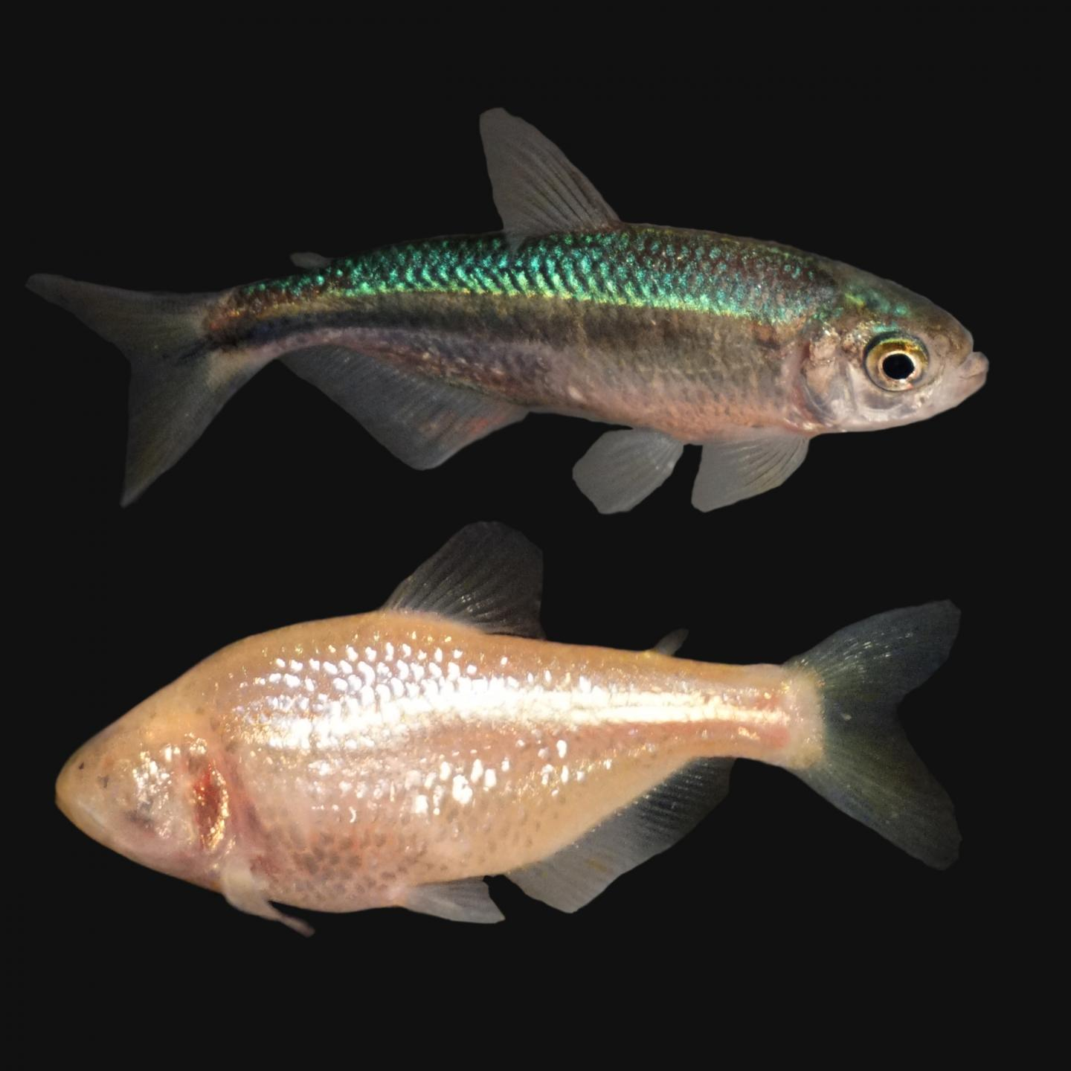
Introduction
Circadian rhythm is an internal genetic timing system primarily dependent on light
Cave animals have limited ability to detect changes in light due to their environment
The Mexican cave fish lives in darkness and has developed troglomorphic characteristics
Astyanax mexicanus is not affected by day/night cycles

Slide 3
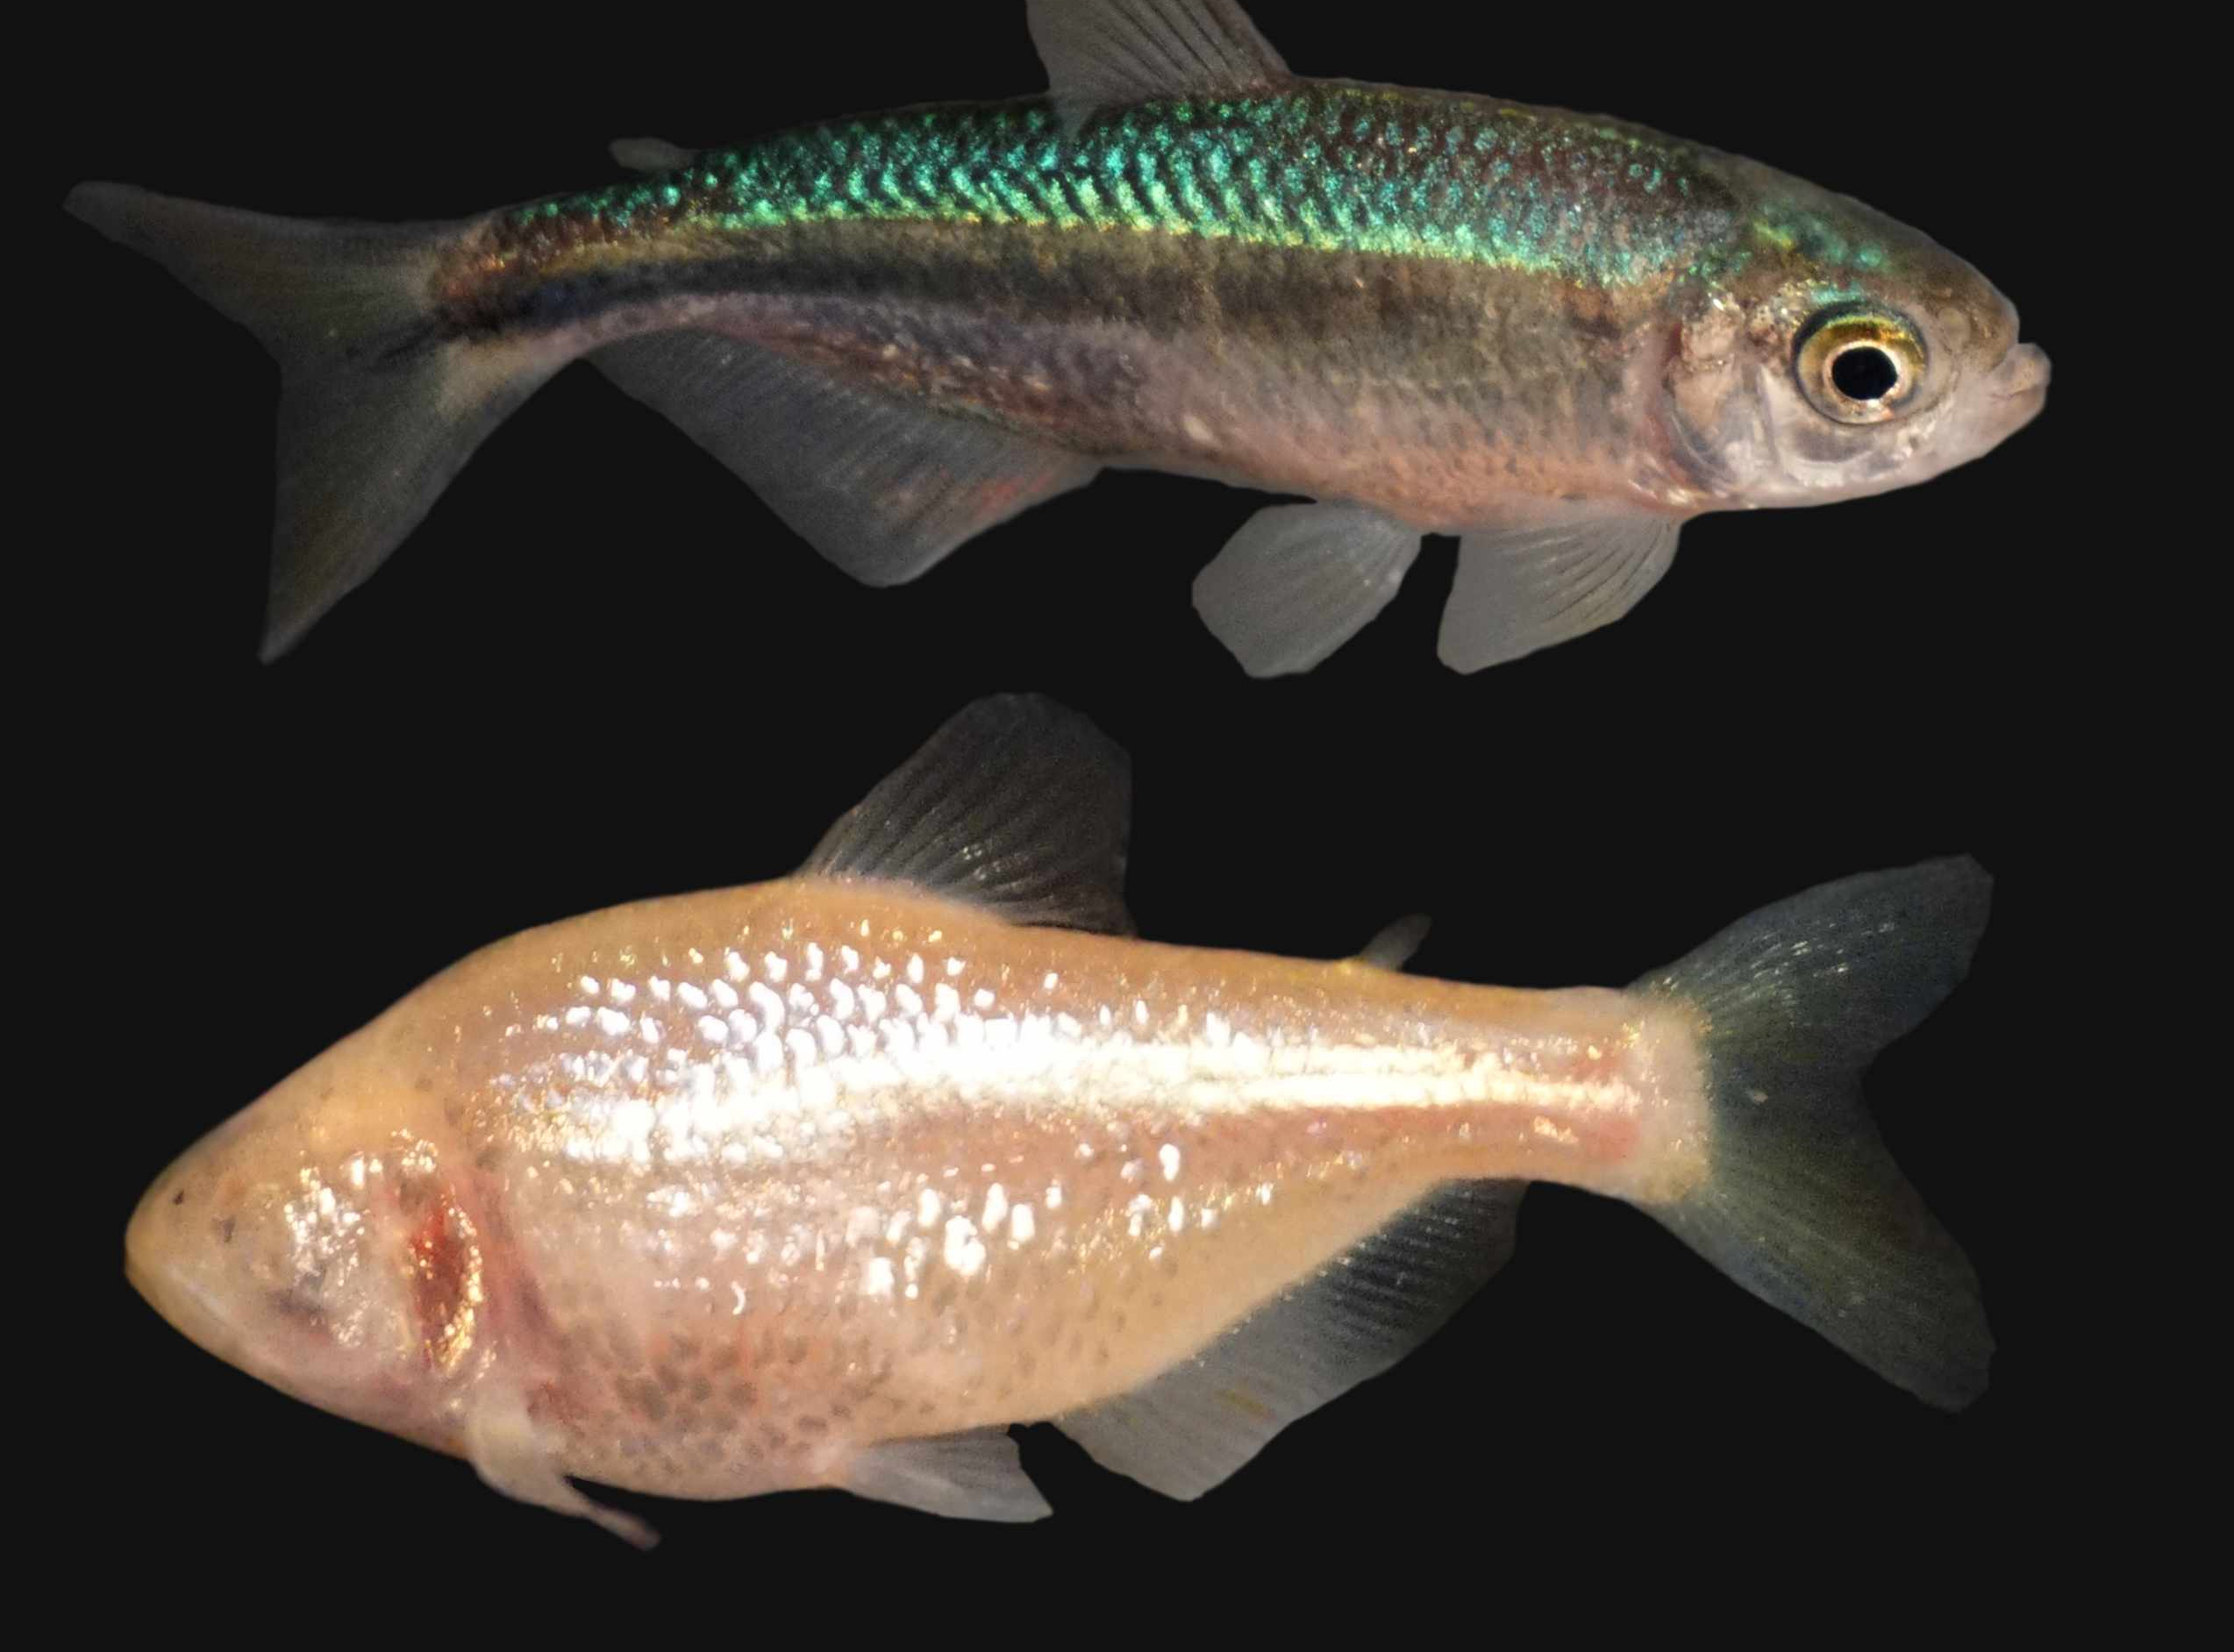
Notes:
Talk about how there are two versions of the same fish during this slide.

Slide 4
Hypothesis:
Astyanax mexicanus has altered circadian rhythm proteins that are reliant on visual perception
Astyanax mexicanus has altered light input pathway

Slide 5
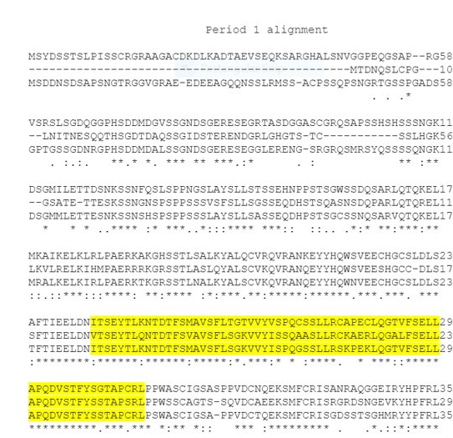



Methods
Missing Sequence
Mummichog
Zebrafish
Cave Fish
NCBI transcriptome searches
BLAST searches for top 5 results
Making Alignments
Phylogenetic trees
Coding Region

Slide 6
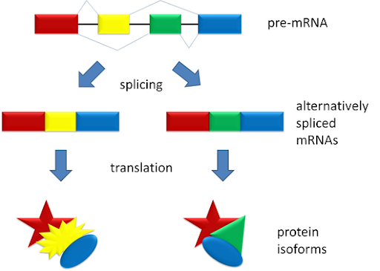
Results: NCBI searches
Core proteins
Accessory proteins
7/20 core protein isoforms not found
9/25 accessory protein isoforms not found

Slide 7
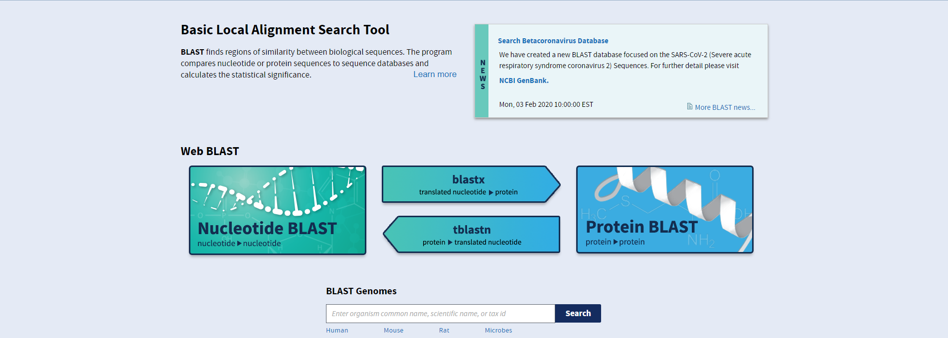
Top 5 BLASTp results
Protein | Sequence ID |  | Species |  |  | Protein Description |  |  |  |  | E-Value | Blast Score
Core
PER1
 | XP_026859577.1 |  | Electrophorus electricus |  |  | LOW QUALITY PROTEIN: period circadian protein homolog 1-like |  |  |  |  | 0 | 1988
 | XP_016372039.1 |  | Sinocyclocheilus rhinocerous* |  |  | PREDICTED: period circadian protein homolog 1-like isoform X1 |  |  |  |  | 0 | 1929
 | XP_016096450.1 |  | Sinocyclocheilus grahami* |  |  | PREDICTED: period circadian protein homolog 1-like isoform X2 |  |  |  |  | 0 | 1869
 | XP_026070899.1 |  | Carassius auratus* |  |  | period circadian protein homolog 1-like |  |  |  |  | 0 | 1862
 | XP_016328367.1 |  | Sinocyclocheilus anshuiensis |  |  | PREDICTED: period circadian protein homolog 1-like isoform X2 |  |  |  |  | 0 | 1859
Core proteins
The same species occurring
Warm, freshwater fish
Sinocyclocheilus
CLOCK 1
 | XP_017543591.1 |  | Pygocentrus nattereri |  |  | PREDICTED: circadian locomoter output cycles protein kaput |  |  |  |  | 0 | 1417
 | XP_027001955.1 |  | Tachysurus fulvidraco* |  |  | circadian locomoter output cycles protein kaput isoform X2 |  |  |  |  | 0 | 1413
 | XP_016149761.1 |  | Sinocyclocheilus grahami* |  |  | PREDICTED: circadian locomoter output cycles protein kaput isoform X2 |  |  |  |  | 0 | 1402
 | XP_017311559.1 |  | Ictalurus punctatus* |  |  | PREDICTED: circadian locomoter output cycles protein kaput isoform X1 |  |  |  |  | 0 | 1397
 | XP_021324029.1 |  | Danio rerio# |  |  | circadian locomoter output cycles protein kaput isoform X2 |  |  |  |  | 0 | 1387
Accessory
Timeless
 | XP_017560258.1 |  | Pygocentrus nattereri# |  |  | PREDICTED: protein timeless homolog isoform X3 |  |  |  |  | 0 | 2047
 | XP_017306586.1 |  | Ictalurus punctatus |  |  | PREDICTED: protein timeless homolog |  |  |  |  | 0 | 1984
 | XP_027021368.1 |  | Tachysurus fulvidraco* |  |  | protein timeless homolog isoform X1 |  |  |  |  | 0 | 1977
 | XP_026788703.1 |  | Pangasianodon hypophthalmus# |  |  | protein timeless homolog isoform X2 |  |  |  |  | 0 | 1944
 | XP_030632952.1 |  | Chanos chanos |  |  | protein timeless homolog isoform X1 Chanos chanos |  |  |  |  | 0 | 1884
Accessory proteins
Model fishes
No clear relationships
FBXL3a
 | XP_017566308.1 |  | Pygocentrus nattereri |  |  | PREDICTED: F-box/LRR-repeat protein 3 |  |  |  |  |  | 0 | 828
 | XP_030642954.1 |  | Chanos chanos |  |  | F-box/LRR-repeat protein 3 |  |  |  |  |  | 0 | 806
 | XP_026128332.1 |  | Carassius auratus* |  |  | F-box/LRR-repeat protein 3-like |  |  |  |  |  | 0 | 801
 | XP_018965108.1 |  | Cyprinus carpio |  |  | PREDICTED: F-box/LRR-repeat protein 3-like |  |  |  |  |  | 0 | 798
 | XP_017324982.1 |  | Ictalurus punctatus |  |  | PREDICTED: F-box/LRR-repeat protein 3 |  |  |  |  |  | 0 | 792
(*) indicates two isoforms found, (#) indicates 3 isoforms found.

Slide 8
Results: Alignments
Core Protein | Coding Region
Period 1 | Per C-Terminal Domain
Period 2a | Per C-Terminal Domain
Period 2b | Per C-Terminal Domain
Clock 1 | Coiled-Coil Motif
Chryptochrome 1a | DNA Photolase Domain; FAD Binding Domain
Chryptochrome 1b | DNA Photolase Domain; FAD Binding Domain
Chryptochrome 2 | DNA Photolase Domain; FAD Binding Domain
Astyanax mexicanus lacks core circadian protein isoforms

Slide 9
Results: Alignments
Core Protein | Coding Region
Period 1 | Coiled-Coil Motif
Period 2a | Tubulin; Tubulin-C
Chryptochrome2 | Coiled-Coil Motif
Fundulus heteroclitus possessed more coding regions

Slide 10
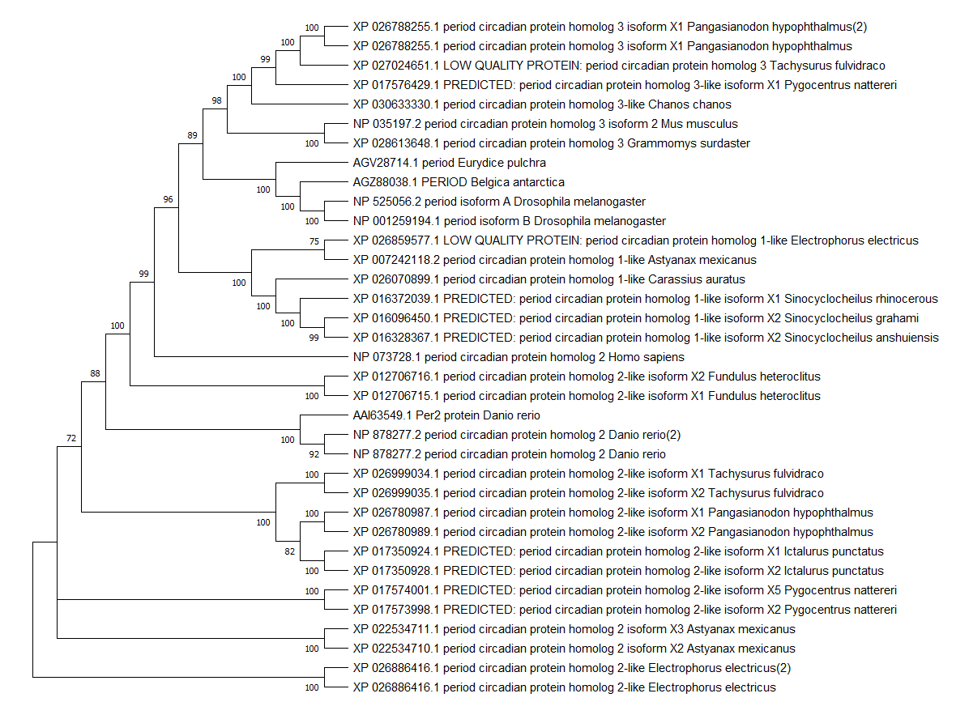



Results: Phylogenetic Tree
Shows which Period proteins were likely derived from which
Period 2a appears derived
Period 2bI, Period2bII both appear old

Slide 11
Discussion: Astyanax transcriptome
Am may have never doubled its transcriptome
Poor coverage in NCBI
lost those isoforms due to their environment
Rounds of whole genome duplication during evolution
Astyanax mexicanus has 70X genome coverage
Cave animals don’t need light input genes
Notes:
Read this not keep it on slide

Slide 12
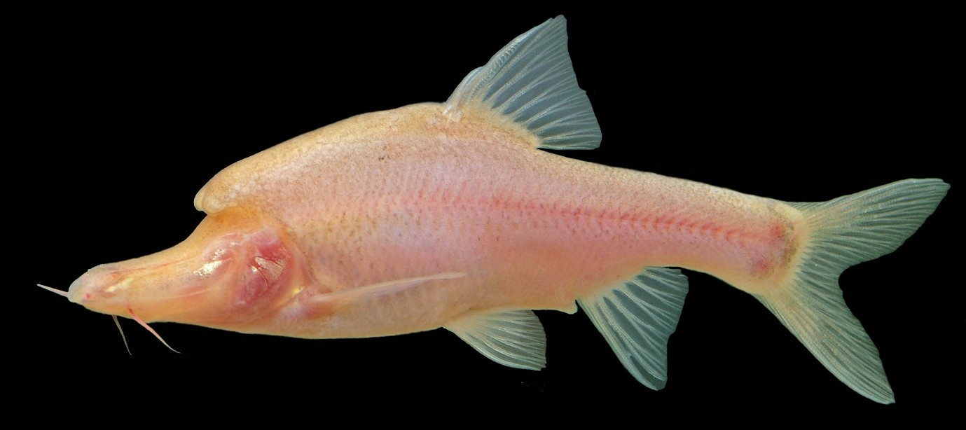
Discussion: Top 5 blast results
Core proteins similar enough fish in same geographic region
Genus Sinocyclocheilus
Accessory proteins need more sequencing
More fish circadian transcriptome needs sequencing
Cave animals need sequencing

Slide 13
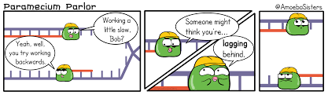
Discussion: Alignments and Phylogenetic Tree
Danio rerio and Fundulus heteroclitus may have more coding regions than Astyanax mexicanus
Danio rerio and Fundulus heteroclitus have more available core protein forms
Possible Astyanax mexicanus has lost or altered some transcriptome
Possible Astyanax has added less transcriptome than other fish

Slide 14
Future Study
Epigenetic factors
Phenotypic plasticity
More cave fish

Slide 15
Acknowledgements – Thank you
Dr. Chabot & Brendan Riley for providing mummichog and zebrafish circadian transcriptome as well as the blueprint methods.
Dr. Jolles for helping us throughout our project
Dr. Chabot again for mentoring us throughout our research

Slide 16
Literature Cited
Reppert, S. M., & Weaver, D. R. (2002). Coordination of circadian timing in mammals. Nature, 418(6901), 935-941
Stemmer, M., Schuhmacher, L. N., Foulkes, N. S., Bertolucci, C., & Wittbrodt, J. (2015). Cavefish eye loss in response to an early block in retinal differentiation progression. Development, 142(4), 743-752.
Yamazaki, S., Numano, R., Abe, M., Hida, A., Takahashi, R. I., Ueda, M., ... & Tei, H. (2000). Resetting central and peripheral circadian oscillators in transgenic rats. Science, 288(5466), 682-685.
Beale, A., Guibal, C., Tamai, T. K., Klotz, L., Cowen, S., Peyric, E., ... & Whitmore, D. (2013). Circadian rhythms in Mexican blind cavefish Astyanax mexicanus in the lab and in the field. Nature communications, 4(1), 1-10.
Marzban, H., Hoy, N., Buchok, M., Catania, K. C., & Hawkes, R. (2015). Compartmentation of the cerebellar cortex: adaptation to lifestyle in the star-nosed mole Condylura cristata. The Cerebellum, 14(2), 106-118
Chesmore, K. N., Watson III, W. H., & Chabot, C. C. (2016). Identification of putative circadian clock genes in the American horseshoe crab, Limulus polyphemus. Comparative Biochemistry and Physiology Part D: Genomics and Proteomics, 19, 45-61.
Allada, R., & Chung, B. Y. (2010). Circadian organization of behavior and physiology in Drosophila. Annual review of physiology, 72, 605-624.
Dunlap, J. C. (1999). Molecular bases for circadian clocks. Cell, 96(2), 271-290.
Reilly, B., & Chabot, C. (2020). Identification of a putative circadian system in the mummichog, Fundulus heteroclituss. Unpublished manuscript, Department of Biological Sciences, Plymouth State University, Plymouth, New Hampshire, United States of America
(6), 1547-1549.
Jeffery, W. R. (2005). Adaptive evolution of eye degeneration in the Mexican blind cavefish. Journal of Heredity, 96(3), 185-196.

Slide 17
More Literature Cited
Madeira, F., Park, Y. M., Lee, J., Buso, N., Gur, T., Madhusoodanan, N., ... & Lopez, R. (2019). The EMBL-EBI search and sequence analysis tools APIs in 2019. Nucleic acids research, 47(W1), W636-W64
Cavallari Nicola, Frigato Elena, Vallone Daniela, Fröhlich Nadine, Fernando Lopez-Olmeda Jose, Foà Augusto, Berti Roberto, Javier Sánchez-Vázquez Francisco, Bertolucci Christiano, S. Foulkes Nicholas. (2011). A Blind Circadian Clock in Cavefish Reveals that Opsins Mediate Peripheral Clock Photoreception. PLOS Biology.
Ceinos, Rosa & Frigato, Elena & Pagano, Cristina & Fröhlich, Nadine & Negrini, Pietro Foulkes, Nicholas & Whitmore, David & Vallone, Daniela & Bertolucci, Cristiano. (2016). Studying the Evolution of the Vertebrate Circadian Clock: The Power of Fish as Comparative Models. 10.1016/bs.adgen.2016.05.002.
Friedrich, Markus. (2013). Biological Clocks and Visual Systems in Cave-Adapted Animals at the Dawn of Speleogenomics. Integrative and comparative biology. 53. 10.1093/icb/ict058
Hong Sun, Qianqian Dong, Chenchen Wanga, Mengwan Jianga, Baishi Wang, Zhenlong Wang. (2018). Evolution of circadian genes PER and CRY in subterranean rodents. International Journal of Biological Macromolecules 118(B) 1400-1405.
Smit, Andrea & Broesch, Tanya & Siegel, Jerome & Mistlberger, Ralph. (2019). Sleep timing and duration in indigenous villages with and without electric lighting on Tanna Island, Vanuatu. Scientific Reports. 9. 10.1038/s41598-019-53635-y.
Van Jaarsveld, Barry & Bennett, Nigel & Hart, Daniel & Oosthuizen, Maria. (2018). Locomotor activity and body temperature rhythms in the Mahali mole-rat (C. h. mahali): The effect of light and ambient temperature variations. Journal of Thermal Biology. 79. 24-32. 10.1016/j.jtherbio.2018.11.013.
Villamizar, Natalia & Blanco-Vives, Borja & Oliveira, Catarina & Dinis, Maria & Rosa, Viviana & Negrini, Pietro & Bertolucci, Cristiano & Sanchez Vazquez, F. Javier. (2013). Circadian Rhythms of Embryonic Development and Hatching in Fish: A Comparative Study of Zebrafish (Diurnal), Senegalese Sole (Nocturnal), and Somalian Cavefish (Blind). Chronobiology international. 30. 10.3109/07420528.2013.784772.
NCBI Resource Coordinators (2016). Database resources of the National Center for Biotechnology Information. Nucleic acids research, 44(D1), D7–D19. https://doi.org/10.1093/nar/gkv1290
Klaus, S., Mendoza, J. C., Liew, J. H., Plath, M., Meier, R., & Yeo, D. C. (2013). Rapid evolution of troglomorphic characters suggests selection rather than neutral mutation as a driver of eye reduction in cave crabs. Biology letters, 9(2), 20121098. https://doi.org/10.1098/rsbl.2012.1098
Madeira, F., Park, Y. M., Lee, J., Buso, N., Gur, T., Madhusoodanan, N., ... & Lopez, R. (2019). The EMBL-EBI search and sequence analysis tools APIs in 2019. Nucleic acids research, 47(W1), W636-W641.
Letunic, I., & Bork, P. (2018). 20 years of the SMART protein domain annotation resource. Nucleic acids research, 46(D1), D493-D496.
Kumar, S., Stecher, G., Li, M., Knyaz, C., & Tamura, K. (2018). MEGA X: molecular evolutionary genetics analysis across computing platforms. Molecular biology and evolution, 35

Slide 18
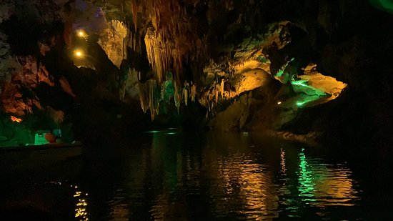
Any Questions?

